Slide 1
Group 1
Members
1.Adrian Osogo
2.Terrence Katua
3.Emmanuel Kanyiri
4.Innocent Ndeti
5.James Njao

Slide 2
Project Goal:
Develop a java desktop application (Swing) that imports CSV admissions data into a normalized relational DB, performs analytics and displays results with visualizations.
The university application analyzes university admission data from 3 csv files:
applicants.csv
applications.csv
exam_scores.csv

Slide 3
Table of Contents
Normalised data structure
Code section
  SQL code for creation of tables
  JDBC Code
  Jave code for running queries
    Tables
  Code for visualisations
    Charts
Summary
Challanges faced

Slide 4
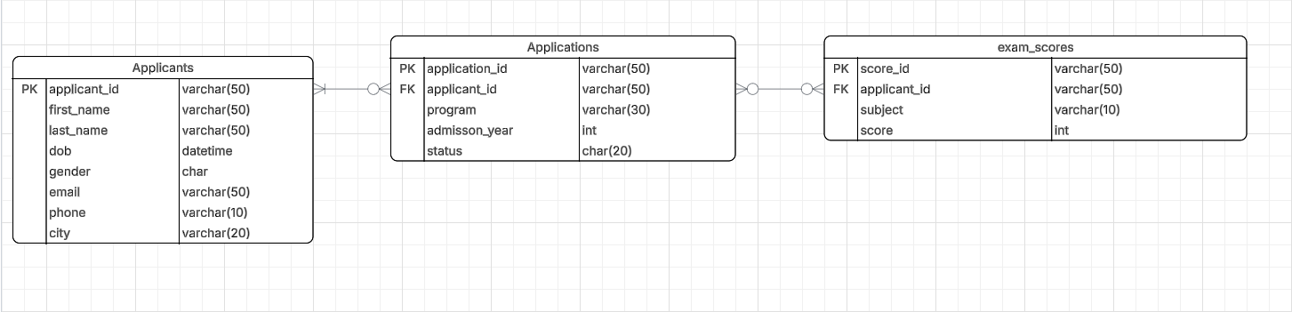
Normalised Data Structure

Slide 5
Code for Creation of tables and columns

Slide 6
Applicants table.
This table keeps all the details about each applicant i.e name, birth date, gender, email, phone, and city.
Every applicant gets a unique applicant ID so the system can identify them easily when linking to other tables like applications or exam scores.
CREATE TABLE applicants (
applicant_id varchar(50) NOT NULL,
first_name varchar(50) DEFAULT NULL,
last_name varchar(50) DEFAULT NULL,
dob datetime DEFAULT NULL,
gender char(1) DEFAULT NULL,
email varchar(50) DEFAULT NULL,
phone varchar(10) DEFAULT NULL,
city varchar(20) DEFAULT NULL,
PRIMARY KEY (applicant_id)
) ENGINE=InnoDB DEFAULT CHARSET=utf8mb4 COLLATE=utf8mb4_0900_ai_ci;

Slide 7
2. Applications Table
This table stores every program an applicant has applied for.
It links each application to the applicant’s ID, the program name, the year of admission, and whether they were accepted or not.
The foreign key connection keeps all records properly linked back to the main applicants table.
CREATE TABLE applications (
application_id VARCHAR(50) NOT NULL,
applicant_id VARCHAR(50) DEFAULT NULL,
program VARCHAR(30) DEFAULT NULL,
admisson_year INT DEFAULT NULL,
status CHAR(20) DEFAULT NULL,
PRIMARY KEY (application_id),
KEY applicant_id (applicant_id),
CONSTRAINT applications_ibfk_1
FOREIGN KEY (applicant_id) REFERENCES applicants (applicant_id)
) ENGINE=InnoDB DEFAULT CHARSET=utf8mb4 COLLATE=utf8mb4_0900_ai_ci;

Slide 8
3. Exam Scores table
The exam_scores table records applicants’ performance in various subjects.
Each entry is uniquely identified by a score_id primary key, with a foreign key (applicant_id) linking each score to its corresponding record in the applicants table.
The table captures subject name and the numeric score, facilitating computation of average scores and comparative analysis across programs.
CREATE TABLE exam_scores (
score_id varchar(50) NOT NULL,
applicant_id varchar(50) DEFAULT NULL,
subject varchar(10) DEFAULT NULL,
score int DEFAULT NULL,
PRIMARY KEY (score_id),
KEY applicant_id (applicant_id),
CONSTRAINT exam_scores_ibfk_1 FOREIGN KEY (applicant_id) REFERENCES applicants (applicant_id)
) ENGINE=InnoDB DEFAULT CHARSET=utf8mb4 COLLATE=utf8mb4_0900_ai_ci;

Slide 9
B. JDBC Code
The University’s Admission system uses JDBC (Java Database Connectivity) to establish a secure and dynamic link between the Java application and the database.
The system loads the appropriate database driver using Class.forName() and establishes a connection through DriverManager.getConnection().
If something goes wrong — like a missing driver or wrong password — the system shows a clear error message instead of crashing through exception handling mechanisms such as catch (ClassNotFoundException cnfe)

Slide 10
try {
Class.forName(driverClass);
conn = DriverManager.getConnection(url, user, password);
} catch (ClassNotFoundException cnfe) {
JOptionPane.showMessageDialog(null, "JDBC Driver not found: " + driverClass + "\nPlease add the JDBC driver JAR to the classpath.", "Driver Error", JOptionPane.ERROR_MESSAGE);
return;
} catch (SQLException sqle) {
JOptionPane.showMessageDialog(null, "Failed to connect: " + sqle.getMessage(), "Connection Error", JOptionPane.ERROR_MESSAGE);
return;
}

Slide 11
Code for running queries

Slide 12
Acceptance rates per program
The code below finds out what percentage of applicants were accepted into each program. It runs a database query and returns results so they can be displayed in a bar chart.
String query = "SELECT b.program, " +
"COUNT(CASE WHEN b.status='Accepted' THEN 1 END)*100.0/COUNT(b.application_id) AS acceptanceRate " +
"FROM applicants AS a LEFT JOIN applications AS b ON a.applicant_id=b.applicant_id " +
"GROUP BY b.program";
ResultSet rs = stmt.executeQuery(query);

Slide 13
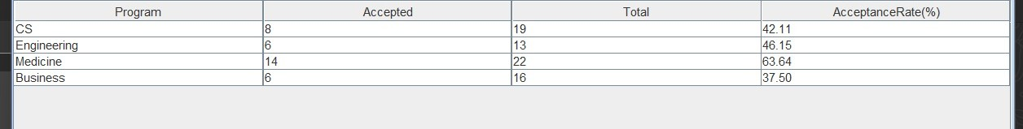

Slide 14
2. Average exam score per program
The following query computes the mean examination score for each program by joining the exam_score and applications tables. The result set enables comparative performance analysis across programs.
ResultSet rs = stmt.executeQuery(
"SELECT b.program, AVG(score) as avg_score " +
"FROM exam_scores e " +
"JOIN applications b ON e.applicant_id = b.applicant_id " +
"GROUP BY b.program"
);

Slide 15
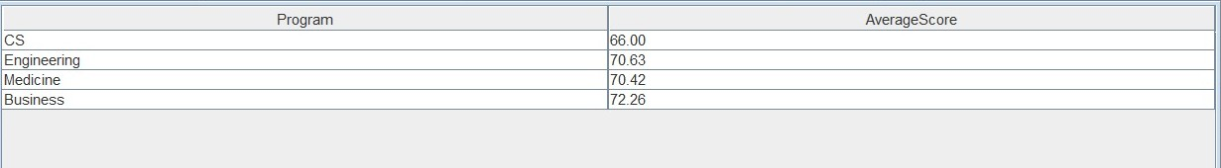

Slide 16
3. Distribution of applicants by city and gender
The query groups applicant records by both city and gender to illustrate demographic distribution. Executed through JDBC, the results populate a Swing table model to visualize regional and gender-based applicant trends.
try (Statement stmt = connection.createStatement()) {
ResultSet rs = stmt.executeQuery(
"SELECT gender, COUNT(*) as count FROM applicants GROUP BY gender"
);
while (rs.next()) {
dataset.setValue(rs.getString("gender"), rs.getInt("count"));
}
}

Slide 17
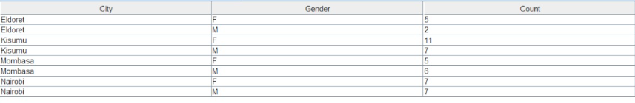

Slide 18
4. Top 10 applicants by average exam score
This query ranks applicants based on their mean examination scores and returns the top ten performers.
try (Statement stmt = connection.createStatement()) {
ResultSet rs = stmt.executeQuery(
"SELECT b.program, AVG(score) as avg_score " +
"FROM exam_scores e " +
"JOIN applications b ON e.applicant_id = b.applicant_id " +
"GROUP BY b.program"
);

Slide 19
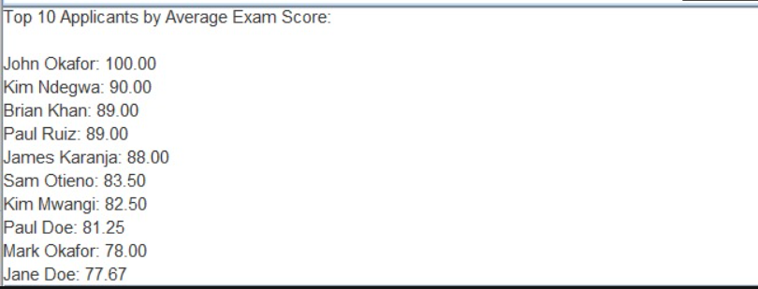

Slide 20
Code for Charts and Outputs

Slide 21
BAR CHART (Exam Scores)
private JPanel createExamScoresHistogram() throws SQLException {​
JPanel panel = new JPanel(new BorderLayout());​
List<Double> scores = new ArrayList<>();​
​
try (Statement stmt = connection.createStatement()) {​
ResultSet rs = stmt.executeQuery("SELECT score FROM exam_scores");​
while (rs.next()) {​
scores.add(rs.getDouble("score"));​
}​
}​
​

Slide 22
double[] scoreArray = scores.stream().mapToDouble(d -> d).toArray();​
HistogramDataset dataset = new HistogramDataset();​
dataset.addSeries("Scores", scoreArray, 20);​
​
JFreeChart chart = ChartFactory.createHistogram(​
"Distribution of Exam Scores",​
"Score",​
"Frequency",​
dataset,​
PlotOrientation.VERTICAL,​
true, true, false​
);​
​
ChartPanel chartPanel = new ChartPanel(chart);​
panel.add(chartPanel);​
return panel;​
}​

Slide 23
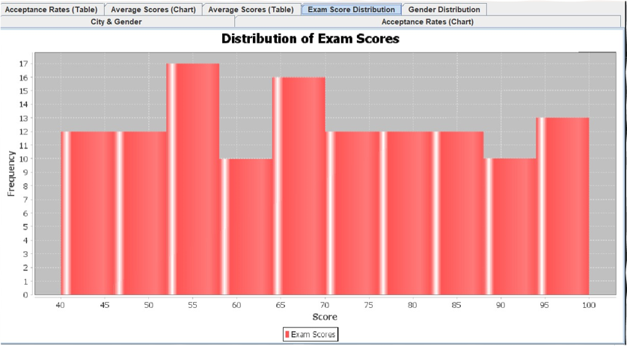
Bar Chart
Output

Slide 24
2. Histogram (Acceptance rate)
Code:
private JPanel createAcceptanceRatesChart() throws SQLException {​
JPanel panel = new JPanel(new BorderLayout());​
DefaultCategoryDataset dataset = new DefaultCategoryDataset();​
​
try (Statement stmt = connection.createStatement()) {​
String query = "SELECT b.program, " +​
"COUNT(CASE WHEN b.status='Accepted' THEN 1 END)*100.0/COUNT(b.application_id) AS acceptanceRate " +​
"FROM applicants AS a LEFT JOIN applications AS b ON a.applicant_id=b.applicant_id " +​
"GROUP BY b.program";​
ResultSet rs = stmt.executeQuery(query);​
​

Slide 25
while (rs.next()) {​
dataset.addValue(rs.getDouble("acceptanceRate"),​
"Acceptance Rate",​
rs.getString("program"));​
}​
}​
​
JFreeChart chart = ChartFactory.createBarChart(​
"Acceptance Rate per Program",​
"Program",​
"Acceptance Rate (%)",​
dataset,​
PlotOrientation.VERTICAL,​
true, true, false​
);​
​
ChartPanel chartPanel = new ChartPanel(chart);​
panel.add(chartPanel);​
return panel;​
}

Slide 26
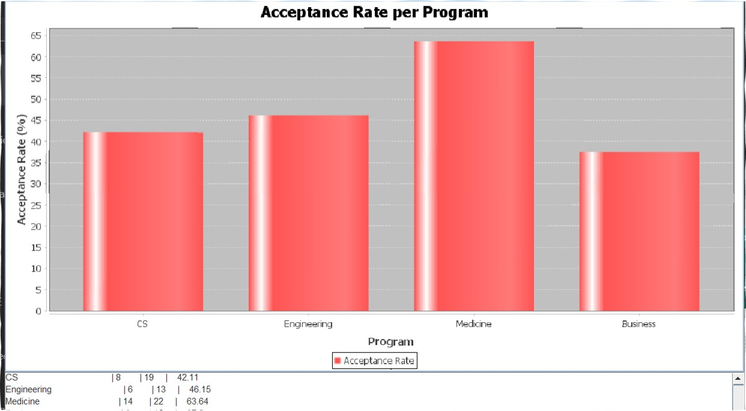
Histogram
Output

Slide 27
3. Pie chart (Gender Distribution)
Code:
private JPanel createGenderDistributionChart() throws SQLException {​
JPanel panel = new JPanel(new BorderLayout());​
DefaultPieDataset dataset = new DefaultPieDataset();​
​
try (Statement stmt = connection.createStatement()) {​
ResultSet rs = stmt.executeQuery(​
"SELECT gender, COUNT(*) as count FROM applicants GROUP BY
gender"​
);​
while (rs.next()) {​
dataset.setValue(rs.getString("gender"), rs.getInt("count"));​
}​
​

Slide 28
}​
JFreeChart chart = ChartFactory.createPieChart(​
"Gender Distribution",​
dataset,​
true, true, false​
);​
PiePlot plot = (PiePlot) chart.getPlot();​
plot.setLabelGenerator(new StandardPieSectionLabelGenerator(​
"{0}: {1} ({2})",​
new DecimalFormat("0"),​
new DecimalFormat("0.0%")​
));​
ChartPanel chartPanel = new ChartPanel(chart);​
panel.add(chartPanel);​
return panel;​
}​

Slide 29
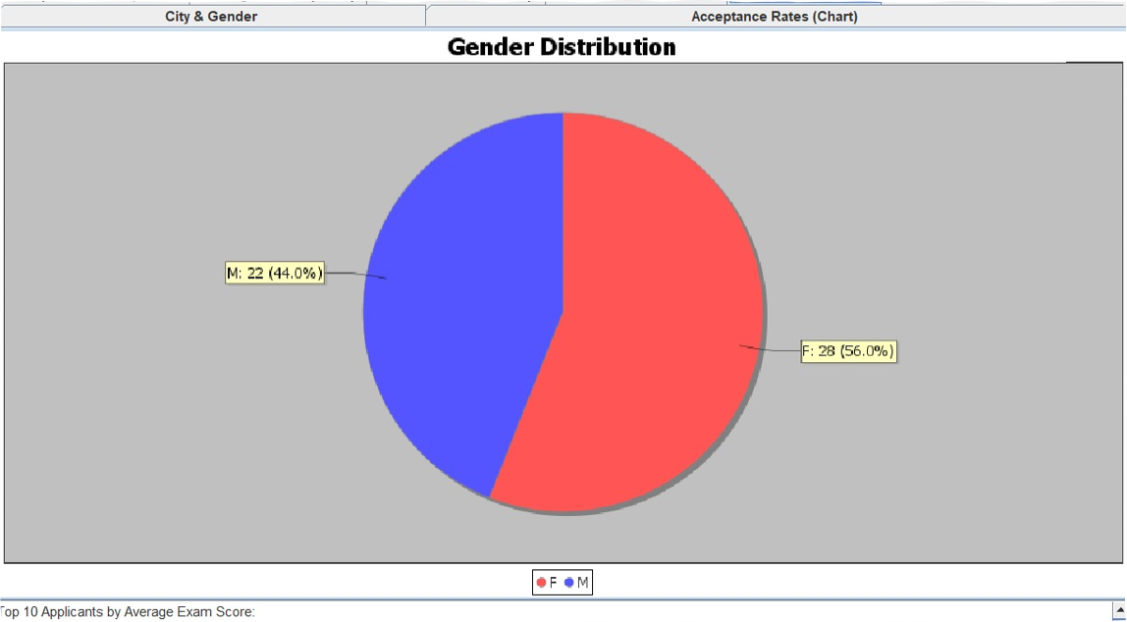
Pie chart
Output
​

Slide 30
Summary
Findings
Insights

Slide 31
Challenges faced

